Slide 1
Born to Storms A Story of Our Climate Crisis
Tom Riley
TomRiley@bigmoondig.com

Slide 2
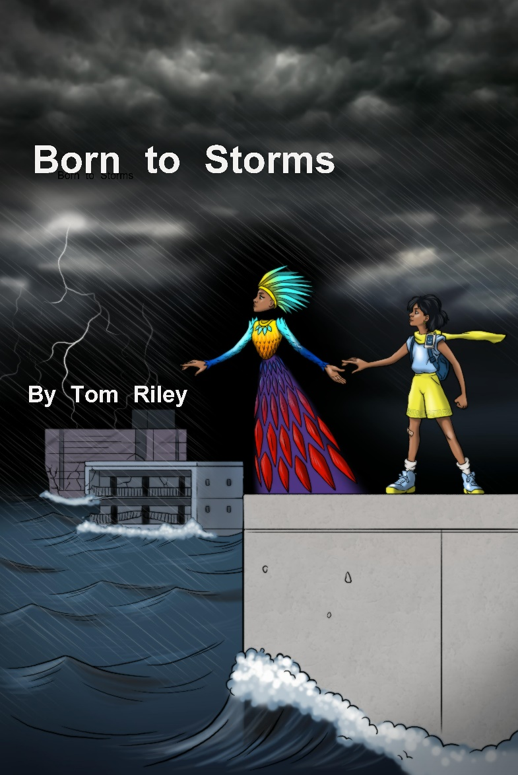
Born to Storms Project:
Tom Riley, Baltimore, USA
Novel for Young People
About Our Climate Crisis

Slide 3
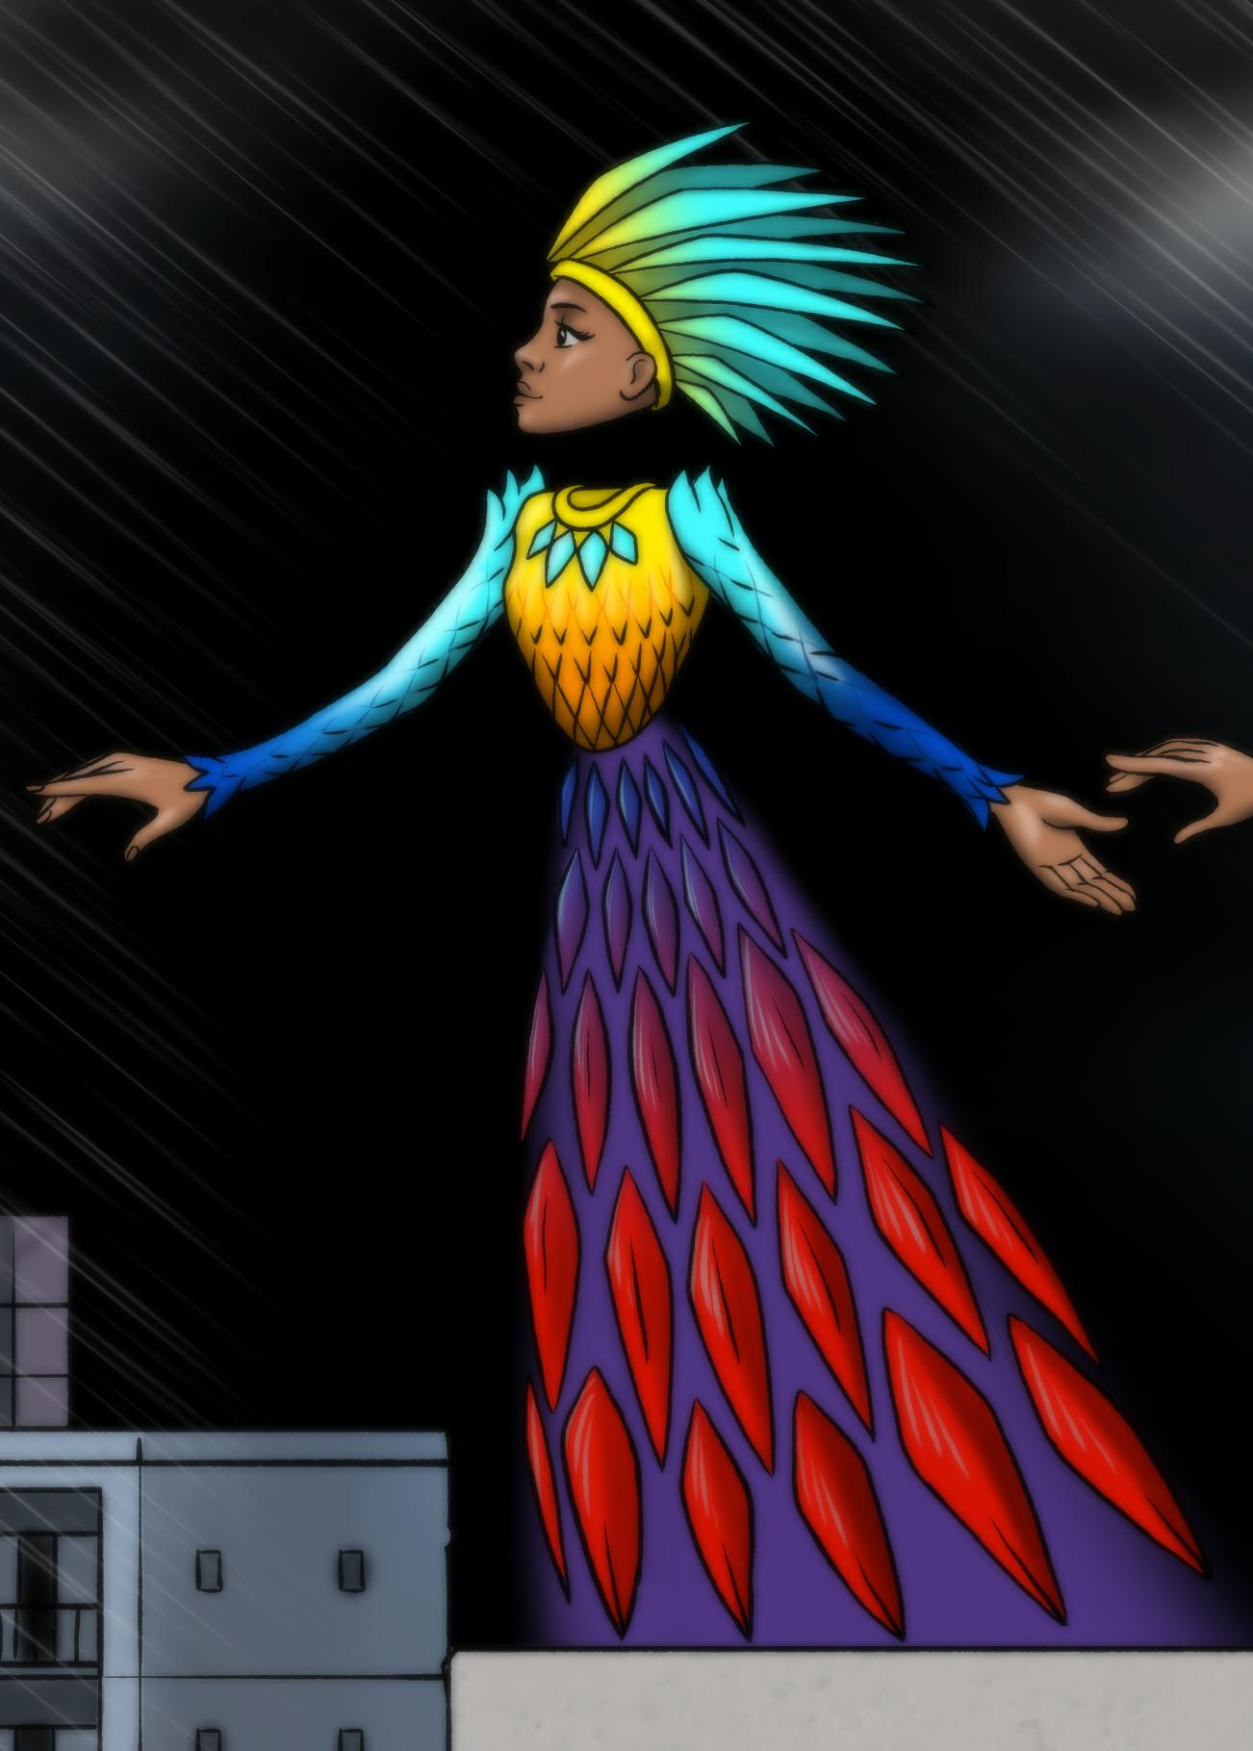
Let the AI Speak
Speaker: JanetA, an AI
(Run Video)

Slide 4
Contact:
Tom Riley
TomRiley@bigmoondig.com
Project Web Site:
https://bigmoondig.com/Stories/BMDStoriesBtS.html

